Slide 1
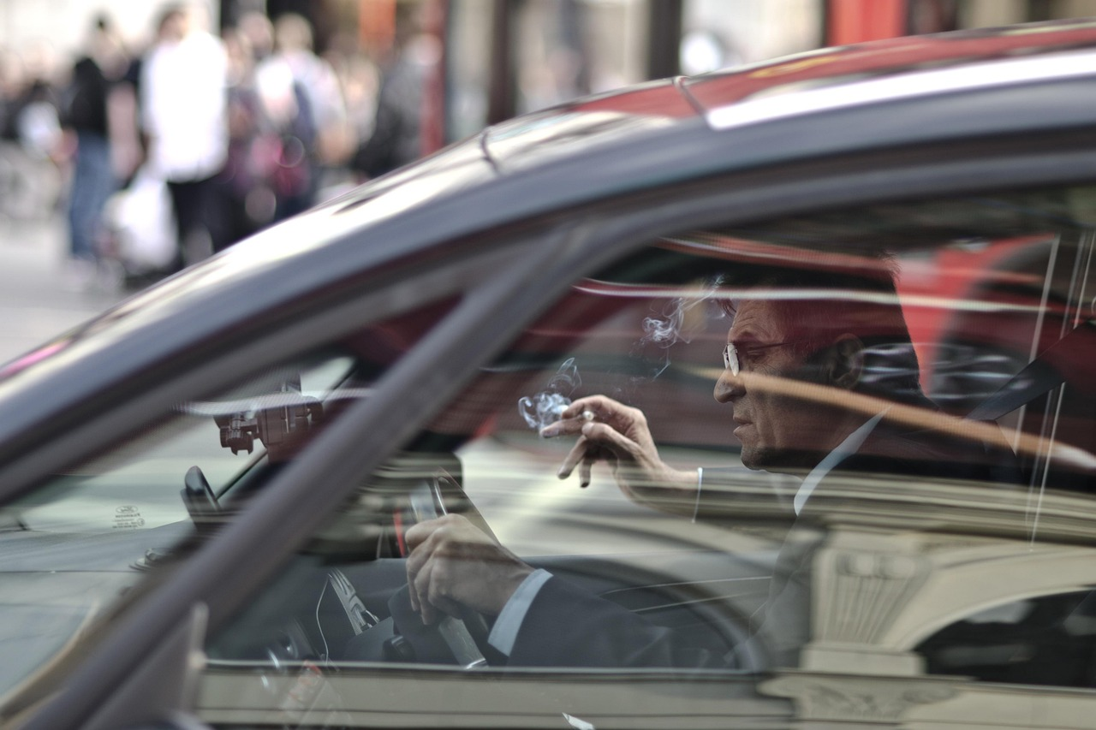
Smart Driver Monitoring System with Live Alerts Using Flask YOLOv10

Slide 2
TABLE OF CONTENTS
Project Description
Problem Statement
Objective
Scope
Significant
Existing System
Proposed System
Architecture
Resource Requirements
Research Gap analysis
Literature Survey
Implementation
Model Implementation
1. Algorithm Definition
2. working Process
✓ UMLs
✓ Results
✓ Output Screens
✓ Conclusion
✓ Future Scope
✓ References

Slide 3
PROJECT DESCRIPTION
This project presents a Smart Driver Monitoring System built using Flask and YOLOv10 to detect unsafe driver behaviors through live camera input. The system identifies multiple driver states, including distracted, drowsy, drinking, eating, phone use, safe driving, seatbelt, and smoking. The detection workflow is supported by a custom dataset and a trained YOLOv10 model that processes video frames in a browser interface. When unsafe behavior such as drowsiness or distraction is identified, the system sends a notification email to the administrator for immediate attention. The platform includes user modules such as Home, Register, Login, Detection, and Logout, providing a complete and structured interface for users. The combination of Flask on the backend and HTML, CSS, and JavaScript on the frontend ensures seamless communication between the detection model and the user interface. This system aims to assist in monitoring driver conditions and promoting safer driving practices through automated identification and alerting. Its simple design and efficient processing make it suitable for projects focused on driver behavior analysis, safety systems, and computer-vision-based monitoring frameworks.

Slide 4
PROBLEM STATEMENT
Driver behavior errors often lead to unsafe conditions, and identifying such behaviors manually is challenging. Without automated monitoring, unsafe actions such as drowsiness, distraction, phone use, or ignoring safety practices may go unnoticed. Traditional methods lack adaptability and do not provide continuous observation. There is a need for a system that can classify driver actions accurately and respond instantly when an unsafe pattern is detected. The main problem this project addresses is the absence of a unified platform that combines behavior detection, live monitoring, and automated alerts. Additionally, there is a gap in integrating an easy-to-use interface with a strong detection model. Therefore, this project aims to build a system that identifies unsafe driver behaviors through camera-based analysis and sends notification alerts to the administrator to support timely intervention.

Slide 5
OBJECTIVE OF PROJECT
The primary objective of this project is to build an efficient monitoring system that can classify different driver behaviors using YOLOv10. Another objective is to integrate this model with a Flask framework to achieve smooth interaction between backend processing and the user interface. The project aims to develop a complete workflow in which users can register, log in, and start live detection through a browser. A key objective is to ensure accurate identification of unsafe behaviors, especially drowsiness and distraction, which trigger automatic email notifications to the administrator. Additional goals include presenting detection results clearly, maintaining stable live video processing, and ensuring responsive system behavior. The project also aims to provide a simple, modular structure that can be extended for future work. By combining deep learning, web technology, and automated alerts, the system aims to support research in behavior recognition and safety monitoring.

Slide 6
SCOPE
The scope of this project covers the development of an automated driver monitoring system using Flask and YOLOv10. It focuses on detecting a defined set of driver behaviors: distracted, drowsy, drinking, eating, phone use, safe driving, seatbelt, and smoking. The system operates through a live camera feed, making it suitable for continuous monitoring settings. The scope includes creating modules such as Home, Register, Login, Detection, and Logout for managing users and providing an organized interface. The backend handles model integration, frame processing, and email notifications, while the frontend presents the detection results clearly. The project also involves training or adapting a YOLOv10 model using a labeled dataset from the specified source. The alert mechanism covers unsafe conditions like drowsiness and distraction, ensuring the administrator is informed immediately. Although the system identifies multiple behaviors, its scope is limited to classification and alerting; it does not provide corrective actions or vehicle control. The project is designed for research, experimentation, and demonstration of behavior monitoring using computer vision and deep learning.

Slide 7
SIGNIFICANCE OF PROJECT
The motivation behind developing this system comes from the need to track driver behavior using automated methods. Manual observation or traditional monitoring approaches are often limited, so there is a need for a structured system that can identify unsafe actions without depending on human supervision. Using computer vision techniques and deep learning models enables continuous behavior analysis in a more efficient manner. The intention is to create a system that can recognize specific actions such as drowsiness and distraction and then notify the administrator instantly, helping in early corrective measures. This project also offers a practical way to explore modern detection frameworks, dataset usage, model training, and alert automation. Overall, the motivation is to design a simple, effective, and accessible solution that supports driver safety and contributes to research in automated monitoring technologies.

Slide 8
EXISTING SYSTEM
Traditional driver monitoring systems mainly rely on classic computer-vision techniques and simple machine-learning algorithms. These systems often use methods such as Haar cascade classifiers for face and eye detection, HOG (Histogram of Oriented Gradients) for feature extraction, and SVM (Support Vector Machine) classifiers for behavior identification. Some systems track eye closure or head movement using threshold-based rules instead of learning from large datasets. These older approaches work by extracting handcrafted features from the video frames and then applying basic classifiers to determine whether the driver is attentive or not. While such systems can detect limited patterns like closed eyes or head tilting, they struggle to understand complex behaviors such as phone use, drinking, or multitasking. They also rely heavily on fixed lighting, stable face positions, and controlled environments. Because of these limitations, traditional systems cannot achieve high accuracy when dealing with multiple driver behaviors or varying camera conditions.

Slide 9
Disadvantages of Existing System
· Can detect only a few basic actions
· Struggle with poor lighting or unusual face angles
· Cannot handle multiple behaviors at the same time
· Low accuracy due to handcrafted features
· Not suitable for live monitoring with fast movements
· Hard to adapt to different drivers or environments
· Slow processing and limited automation
· No advanced alerting or smart decision-making

Slide 10
PROPOSED SYSTEM
The proposed system introduces an advanced Smart Driver Monitoring System built using Flask and a YOLOv10 detection model. Unlike older methods that depend on handcrafted features, this system uses deep learning to identify multiple driver behaviors directly from live camera input. The YOLOv10 model analyzes each frame in real time and classifies actions such as distracted driving, drowsiness, drinking, eating, phone use, seatbelt status, smoking, and safe driving. The system is integrated into a web interface that includes modules such as Home, Register, Login, Detection, and Logout. After users log in, the live detection page streams video frames to the backend, where the model processes them and returns the prediction results.
A key feature of the system is its alert mechanism. When the model detects unsafe behavior—especially drowsiness or distraction—it automatically sends a notification email to the administrator. This creates a simple but effective safety layer. The system is designed to run smoothly on a web platform, making it easy to operate while providing reliable detection accuracy. The proposed system supports research, improves interaction, and offers a more complete driver behavior analysis setup.

Slide 11
Advantages of Proposed System
· Detects many driver behaviors accurately
· Works with live camera feed
· Learns features automatically through deep learning
· More reliable even in changing conditions
· Sends instant alerts for unsafe behavior
· Easy to use through a simple web interface
· Supports secure login and user management
· Flexible design that can be extended in future

Slide 12
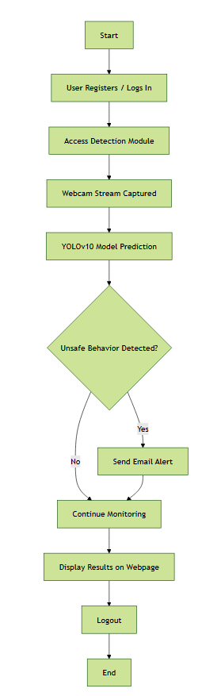
PROJECT FLOW

Slide 13
Resource Requirements
S/W CONFIGURATION:
H/W CONFIGURATION:
Processor - I3/Intel Processor
Hard Disk - 160GB
Key Board - Standard Windows Keyboard
Mouse - Two or Three Button Mouse
Monitor - SVGA
RAM - 8GB
Operating System : Windows 7/8/10
Programming Language : Python
Libraries : Pandas, Numpy, scikit-learn.
IDE/Workbench : Visual Studio Code.

Slide 14
RESEARCH GAP ANALYSIS
Despite significant advancements in driver monitoring systems, several gaps still exist in current research and real-world applications. Many existing solutions focus on detecting only specific behaviors such as drowsiness or phone usage, lacking the ability to classify multiple unsafe actions simultaneously. Traditional systems often rely on older or less efficient models that struggle with real-time performance, limiting their use in continuous monitoring environments. Additionally, many studies emphasize offline image-based detection rather than live video processing, reducing their effectiveness in real driving scenarios.
Another major gap is the lack of fully integrated platforms that combine detection, user management, and automated alerting. While research works present strong computer-vision techniques, they rarely include end-to-end systems with user interfaces, login modules, and live streaming features.Accurate alert mechanisms, such as email notifications for unsafe behaviors, are also missing in many existing approaches. Moreover, several models require high computational power, making deployment difficult for lightweight or practical applications.
This project addresses these gaps by integrating a YOLOv10-based multi-class behavior detection model with a Flask web framework to deliver real-time, browser-based monitoring. It also incorporates automated email alerts for critical behaviors like drowsiness and distraction, filling the gap between research prototypes and functional, user-accessible systems. Overall, the system provides a complete, efficient, and practical solution for modern driver behavior monitoring.

Slide 15
LITERATURE SURVEY
Year | Author(s) | Title | Outcome
2023 | Safarov, F., Akhmedov, F., Abdusalomov, A. B., Nasimov, R., & Cho, Y. I. | Real-Time Deep Learning-Based Drowsiness Detection | Developed a deep-learning system using eye-blink analysis to improve real-time drowsiness detection accuracy and road safety.
2024 | Shen, Q., et al. | Distracted Driving Behavior Detection Algorithm Based on StarDL-YOLO | Proposed an improved YOLO-based algorithm that enhances detection of distracted driving behaviors with higher precision.
2023 | A. C. Phan, … | Driver drowsiness detection and smart alerting using deep learning and IoT | Introduced a deep-learning and IoT-based alert system to identify drowsiness and send automated warnings for increased driver safety.
2024 | Gao, H., … | Improving real-time driver distraction detection via constrained attention mechanism | Presented an attention-based model that enhances the accuracy and speed of real-time driver distraction detection.

Slide 16
IMPLEMENTATION
Algorithm Definitions:
YOLOv10 is the latest version of the popular "You Only Look Once" real-time object detection models, developed by researchers at Tsinghua University. Its primary goal is to achieve an optimal balance between high accuracy and computational efficiency, surpassing previous models like YOLOv8 and YOLOv9. YOLOv10 introduces new architectural designs, specifically a "holistic efficiency-accuracy driven" approach, to streamline the network structure and improve performance without adding excessive computational cost.
Key innovations include the use of efficient "consistent dual assignments" for training and refined architectural components. The result is a model that runs faster and more efficiently while maintaining or improving detection accuracy. The code is officially available on GitHub and integrated into the popular Ultralytics Python package, making it easy to implement. In simple terms, YOLOv10 represents the current state-of-the-art for fast, accurate object detection.

Slide 17
IMPLEMENTATION
Step 1: Dataset Collection & Preparation
Gather labeled images of driver behaviors.
Preprocess and split into training/validation sets.
Step 2: Train YOLOv10 Model
Configure YOLOv10 with custom dataset.
Train, validate, and export the best-performing weights.
Step 3: Build Flask Backend
Integrate trained YOLOv10 model into Flask.
Create routes for login, registration, and detection.
Step 4: Create Frontend Interface
Design Home, Login, Register, Detection pages using HTML, CSS, JS.
Implement live video streaming from the camera.

Slide 18
Step 5: Implement Accurate Detection
Capture frames from the webcam.
Run inference using YOLOv10.
Display detected behaviors in the browser.
Step 6: Email Alert System
Configure SMTP email service.
Trigger email notifications on unsafe actions (e.g., drowsy, distracted).
Step 7: User Authentication & Session Management
Store user credentials.
Enable login, logout, and secure access.

Slide 19
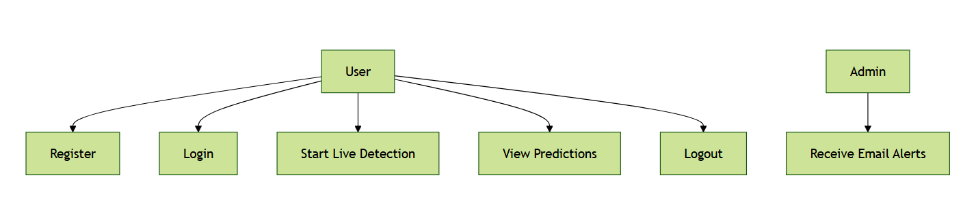
USECASE DIAGRAM
A use case diagram is a visual representation of the functional requirements of a system, showing the interactions between users (actors) and the system through use cases. It helps to identify the system's functionality and the actors involved.

Slide 20
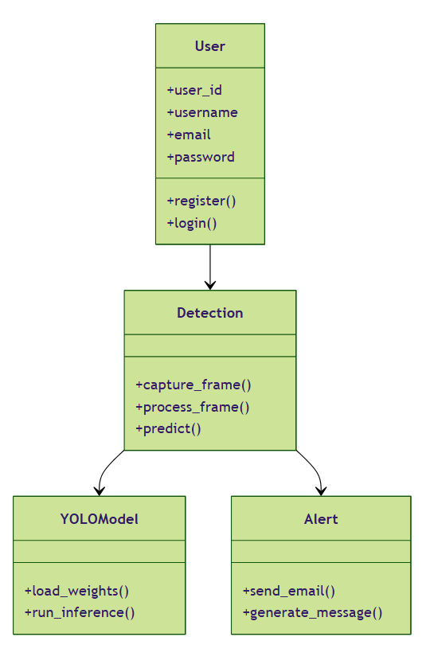
CLASS DIAGRAM
A class diagram is a static structure diagram that represents the system's classes, their attributes, methods, and the relationships between them. It provides a detailed view of the system's data structure and how different classes interact. Class diagrams are essential for object-oriented design and implementation.

Slide 21
SEQUENCE DIAGRAM
A sequence diagram is a behavioral diagram that illustrates how objects interact in a particular sequence of events over time. It shows the order of messages exchanged between objects and their interactions to fulfill a specific scenario or process. This diagram helps in understanding the dynamic behavior of the system.

Slide 22
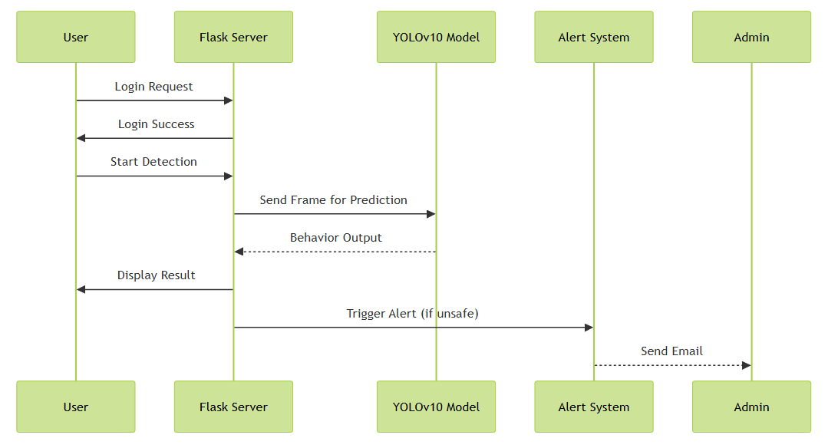
SEQUENCE DIAGRAM

Slide 23
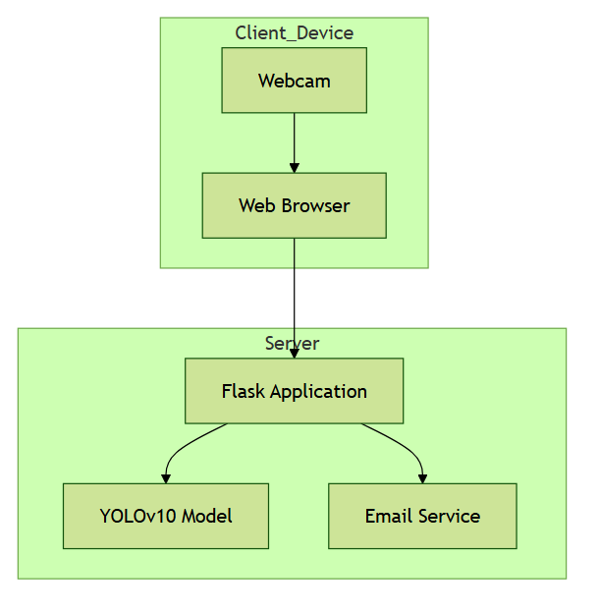
DEPLOYMENT DIAGRAM
A Deployment diagram, also known as a performance diagram, represents the physical performance of software components on hardware nodes. It shows how artifacts, such as executables and libraries, are distributed across hardware components and their relationships. This diagram helps in understanding the system's physical architecture and performance configuration.

Slide 24
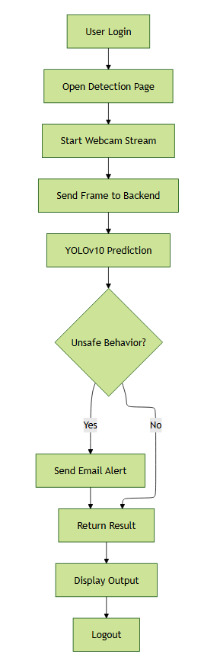
ACTIVITY DIAGRAM
An activity diagram is a behavioral diagram that illustrates the flow of control or data through a series of activities or actions in a system. It represents the dynamic aspects of a process, including decision points, parallel activities, and the sequence of operations. Activity diagrams are useful for modeling workflows and business processes.

Slide 25
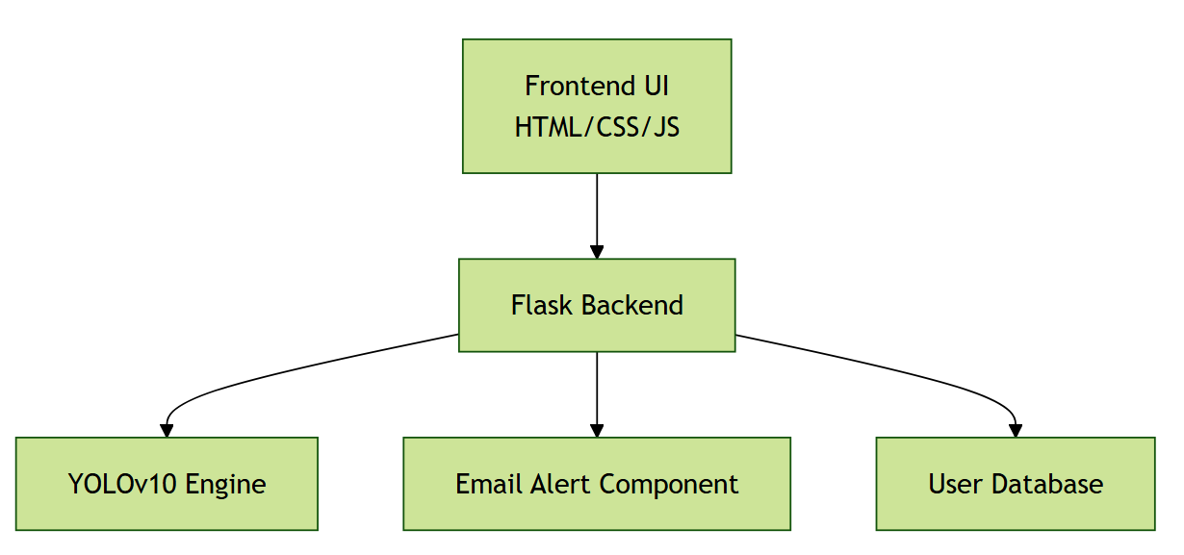
COMPONENT DIAGRAM
A component diagram is a structural diagram that depicts the physical components of a system and their dependencies. It shows how components, such as software packages or modules, are organized and interact with each other to form a complete system. This diagram helps in understanding the high-level structure and organization of the system's components.

Slide 26
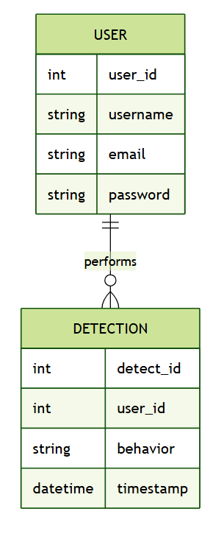
ER DIAGRAM
An Entity-Relationship (ER) diagram is a data model diagram that visually represents the entities, attributes, and relationships within a database. It shows how data entities interact with one another and the nature of their relationships, providing a blueprint for database design. ER diagrams are crucial for designing and understanding database schemas.

Slide 27
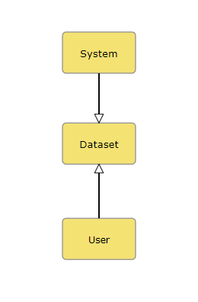
DFD DIAGRAM:
A Data Flow Diagram (DFD) is a traditional way to visualize the information flows within a system. A neat and clear DFD can depict a good amount of the system requirements graphically. It can be manual, automated, or a combination of both. It shows how information enters and leaves the system, what changes the information and where information is stored. The purpose of a DFD is to show the scope and boundaries of a system as a whole. It may be used as a communications tool between a systems analyst and any person who plays a part in the system that acts as the starting point for redesigning a system.
Contrast Level:

Slide 28
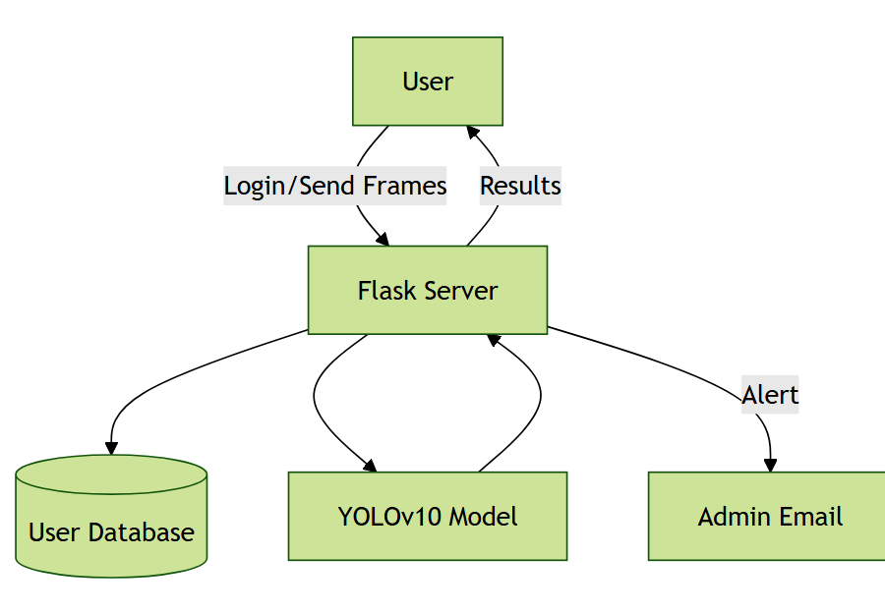
Level 1 Diagram:

Slide 29
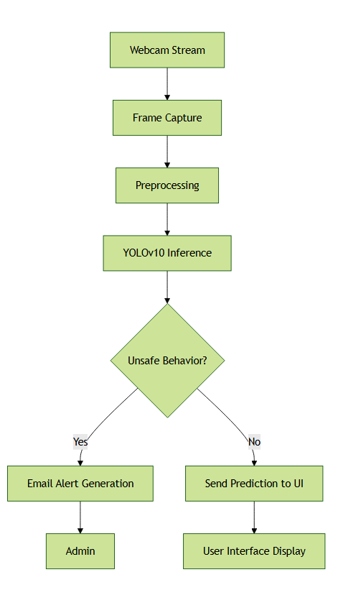
Level 2 Diagram:

Slide 30
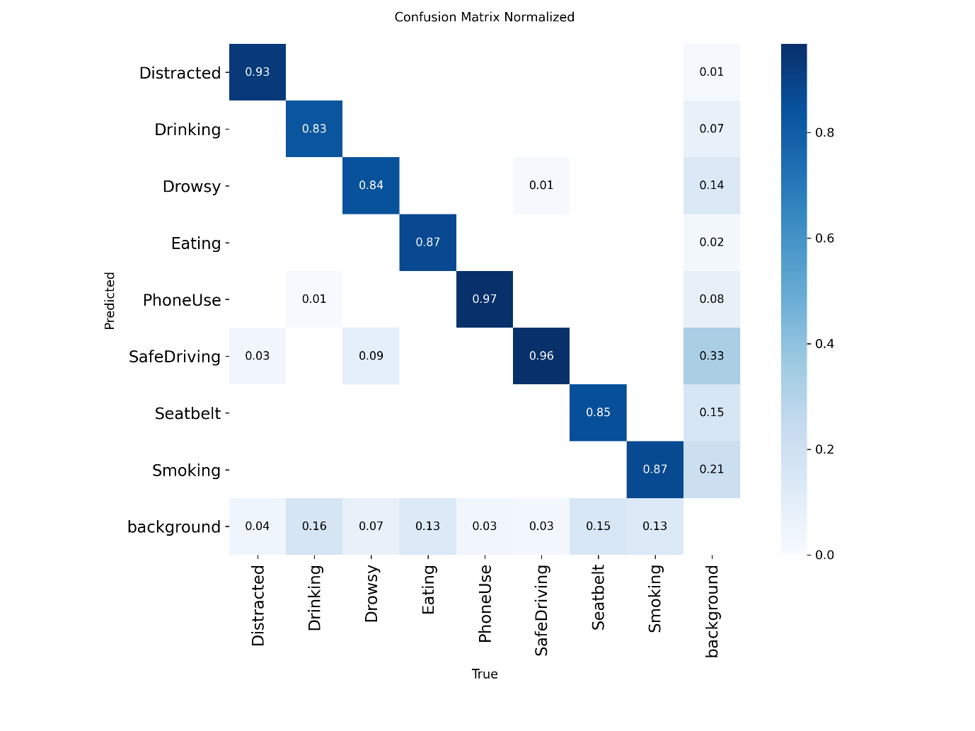
Results
The model predicts "SafeDriving" and "Background" with high accuracy (0.91 and 0.87 respectively).
"Seatbelt" also shows strong performance with 0.83 correct predictions.
Activities like "Eating", "Smoking", and "PhoneUse" are often confused with each other.
"Distracted" has moderate accuracy (0.53) but is frequently misclassified as other activities.
Overall, misclassifications are common among similar behavior classes, indicating room for refinement
confusion matrix for yolov10

Slide 31
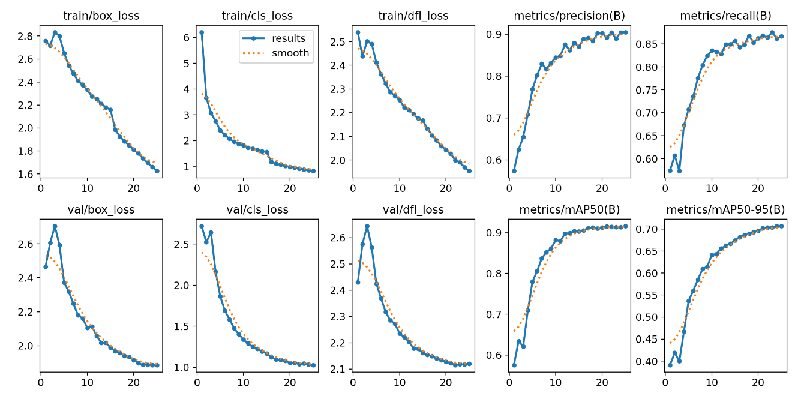
Results
Loss Curves (Top & Bottom Left)
train/box_loss, cls_loss, dfl_loss: These losses steadily decrease, showing the model is learning to localize and classify objects better during training.
val/box_loss, cls_loss, dfl_loss: Validation losses also drop, indicating good generalization and no overfitting.
Performance Metrics (Top & Bottom Right)
Precision & Recall: Both improve over epochs, meaning the model is getting better at correctly identifying objects and finding more of them.
mAP@0.5: Rises consistently, showing strong detection accuracy at standard IoU threshold.
mAP@0.5–0.95: Also increases, reflecting robust performance across stricter overlap criteria.

Slide 32
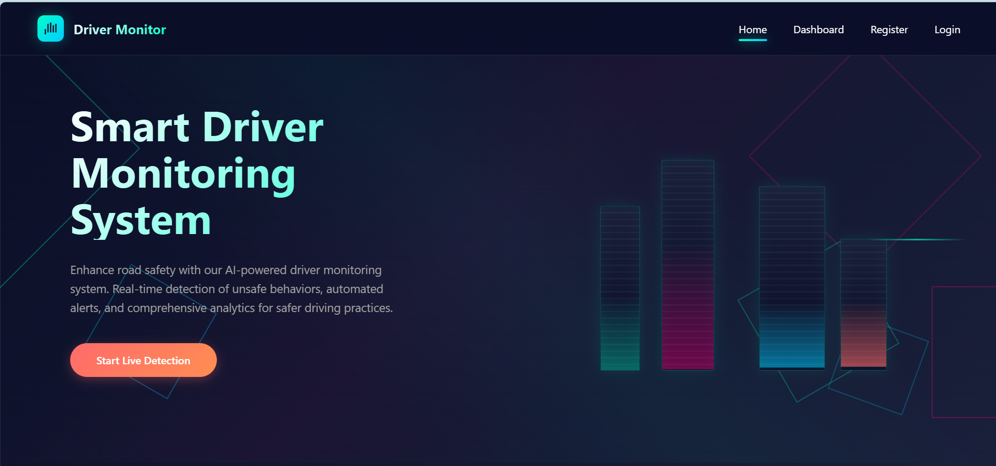
OUTPUT SCREENS
The website includes an index page that serves as the main landing interface for users.

Slide 33
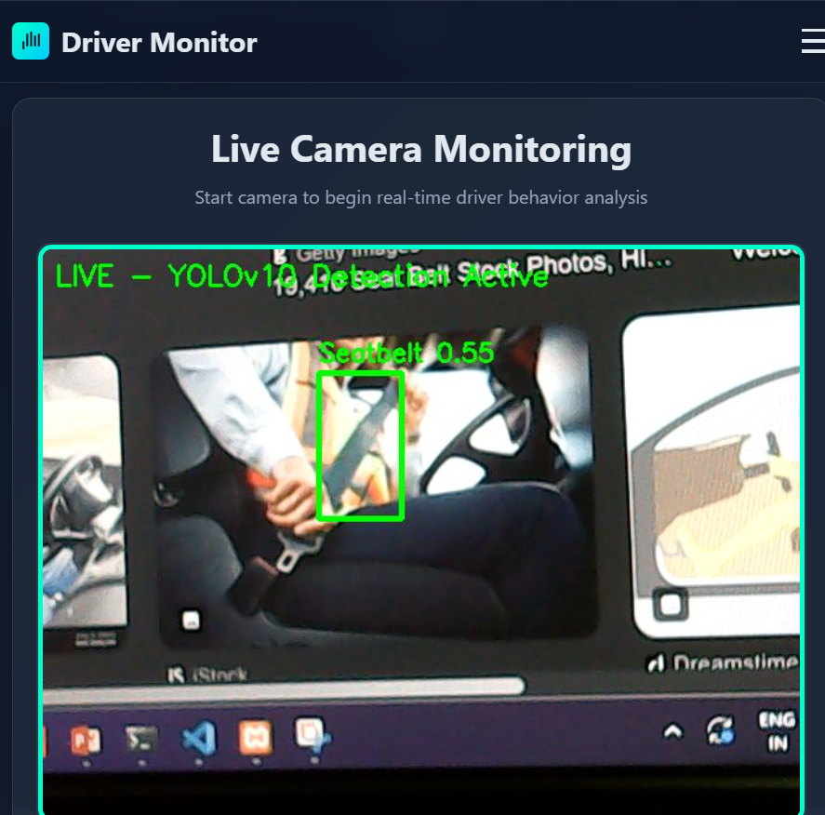
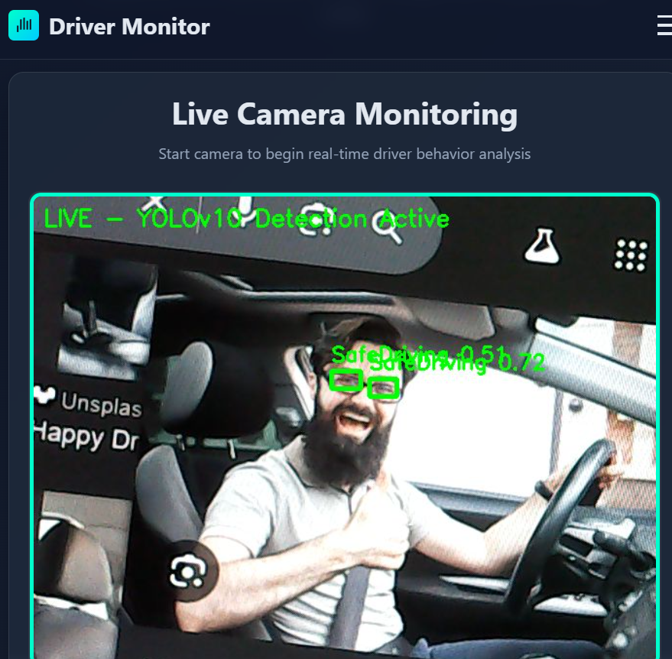
OUTPUT SCREENS
RESULT PAGE: THE RESULT WILL BE DISPLAYED TO THE USER BASED ON LIVE INPUT

Slide 34
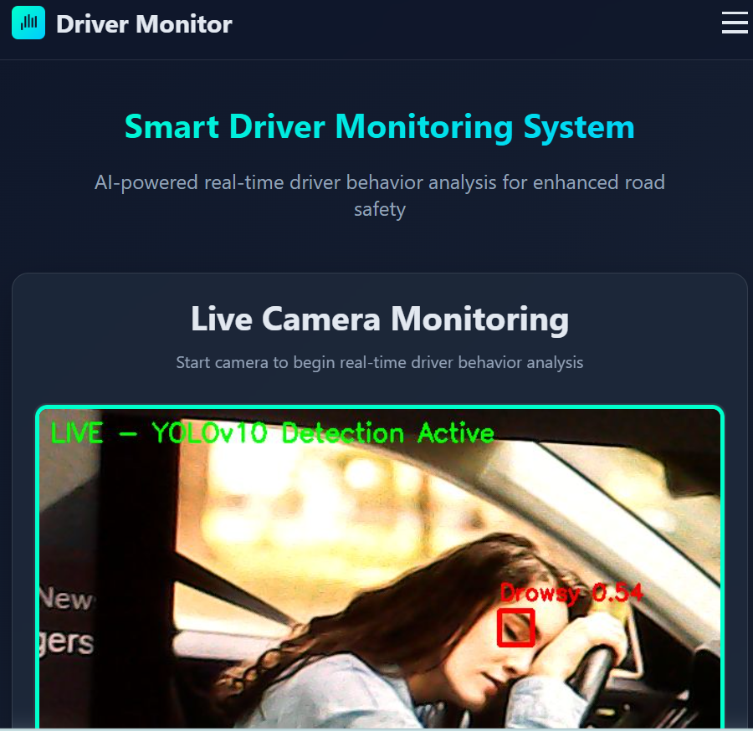
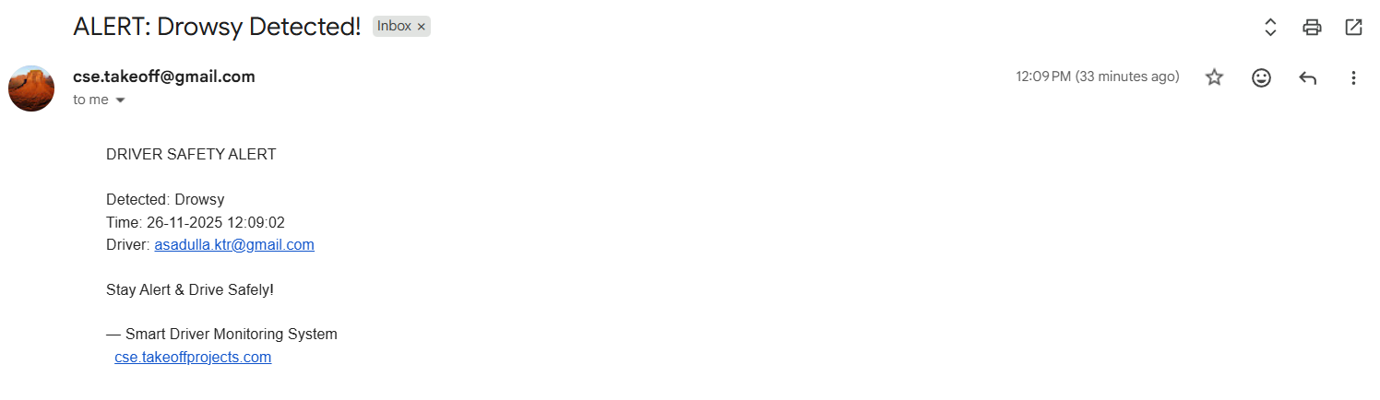
OUTPUT SCREENS
RESULT PAGE: THE RESULT WILL BE DISPLAYED TO THE USER BASED ON LIVE INPUT

Slide 35
Conclusion:
The Smart Driver Monitoring System with Live Alerts using Flask and YOLOv10 successfully demonstrates an automated approach to monitoring driver behavior. The system is capable of identifying multiple driver states such as drowsiness, distraction, drinking, eating, phone use, smoking, seatbelt usage, and safe driving in real time. By integrating YOLOv10 for detection and Flask for the web interface, the project achieves smooth communication between the backend processing and the frontend display.
A key achievement of this project is the real-time alert mechanism. When unsafe behaviors like drowsiness or distraction are detected, the system automatically sends an email notification to the administrator. This feature ensures timely awareness of potential risks without manual supervision. The modular structure, including Home, Register, Login, Detection, and Logout, provides organized user access and secure session management.
The system also demonstrates effective use of deep learning for behavior recognition, preprocessing of live video frames, and real-time prediction display on the web interface. Overall, the project provides a practical and efficient framework for monitoring driver safety. It serves as a foundation for further enhancements, such as integration with multiple cameras or advanced attention mechanisms, and contributes to research in automated behavior monitoring and alert systems.

Slide 36
FUTURE SCOPE:
The Smart Driver Monitoring System provides a strong foundation for automated behavior detection, but there are several opportunities to enhance and extend its functionality. One potential improvement is the integration of multiple camera views inside the vehicle. This would allow the system to monitor the driver from different angles, improving detection accuracy, especially in cases where the face or hands are partially occluded.
Another enhancement could involve incorporating additional sensors, such as eye trackers or heartbeat monitors, to complement the visual data and provide multimodal behavior analysis. This could help detect subtle signs of fatigue or distraction that are difficult to capture through vision alone.
The alert system can also be extended to include mobile or in-vehicle notifications, making it more interactive and immediate. Advanced analytics, such as trend detection or predictive modeling, could allow the system to anticipate unsafe behavior before it occurs.
From a software perspective, implementing a lightweight, optimized version of YOLO for deployment on edge devices would enable the system to run efficiently on embedded hardware. Additionally, integrating machine learning techniques such as attention mechanisms or temporal analysis could improve recognition of complex actions. Overall, these enhancements would make the system more robust, reliable, and adaptable for research, experimentation, and extended applications in driver behavior monitoring.

Slide 37
REFERENCES
Safarov, F., Akhmedov, F., Abdusalomov, A. B., Nasimov, R., & Cho, Y. I. (2023). Real-Time Deep Learning-Based Drowsiness Detection: Leveraging Computer-Vision and Eye-Blink Analyses for Enhanced Road Safety. Sensors. https://doi.org/10.3390/s23146459 (MDPI)
F. M. (2023). Detection of Drowsiness among Drivers Using Novel Deep Convolutional Neural Network Model. Sensors. https://doi.org/10.3390/s23218741 (MDPI)
A. C. Phan, … (2023). Driver drowsiness detection and smart alerting using deep learning and IoT. ScienceDirect. https://doi.org/10.1016/j.something.S2542660523000288 (ScienceDirect)
Q. Shen, … (2024). Distracted Driving Behavior Detection Algorithm Based on StarDL-YOLO. Electronics. https://doi.org/10.3390/electronics13163216 (MDPI)
H. Gao, … (2024). Improving real-time driver distraction detection via constrained attention mechanism. Elsevier. https://doi.org/10.1016/j.ins.2023.09.062 (ScienceDirect)

Slide 38
REFERENCES
C. Khraief Ouled Azaiz, … (2023). In-cabin occupant monitoring system based on improved YOLO, deep reinforcement learning, and multi-task CNN. SPIE Proceedings. https://doi.org/10.1117/12.XXXXX (2023) (Adsabs)
F. Zandamela, D. Kunene, V. Skosana & G. Stoltz (2024). Lightweight YOLO for distracted driver detection on edge devices. MATEC Web of Conferences. https://doi.org/10.1051/matecconf/202440610001 (ResearchGate)
R. Salakapuri, … (2025). Integrated deep learning framework for driver distraction detection combining CNNs and YOLO. Scientific Reports. https://doi.org/10.1038/s41598-025-08475-4 (Nature)
Y. Ma, V. Sanchez, S. Nikan, D. Upadhyay, B. Atote & T. Guha (2023). Robust Multiview Multimodal Driver Monitoring System Using Masked Multi-Head Self-Attention. arXiv. https://arxiv.org/abs/2304.06370 (arXiv)
F. Qu, … (2024). Comprehensive study of driver behavior monitoring systems based on neural networks: taxonomy, challenges, and future directions. Journal of Big Data. https://doi.org/10.1186/s40537-024-00890-0 (SpringerOpen)

